Slide 1
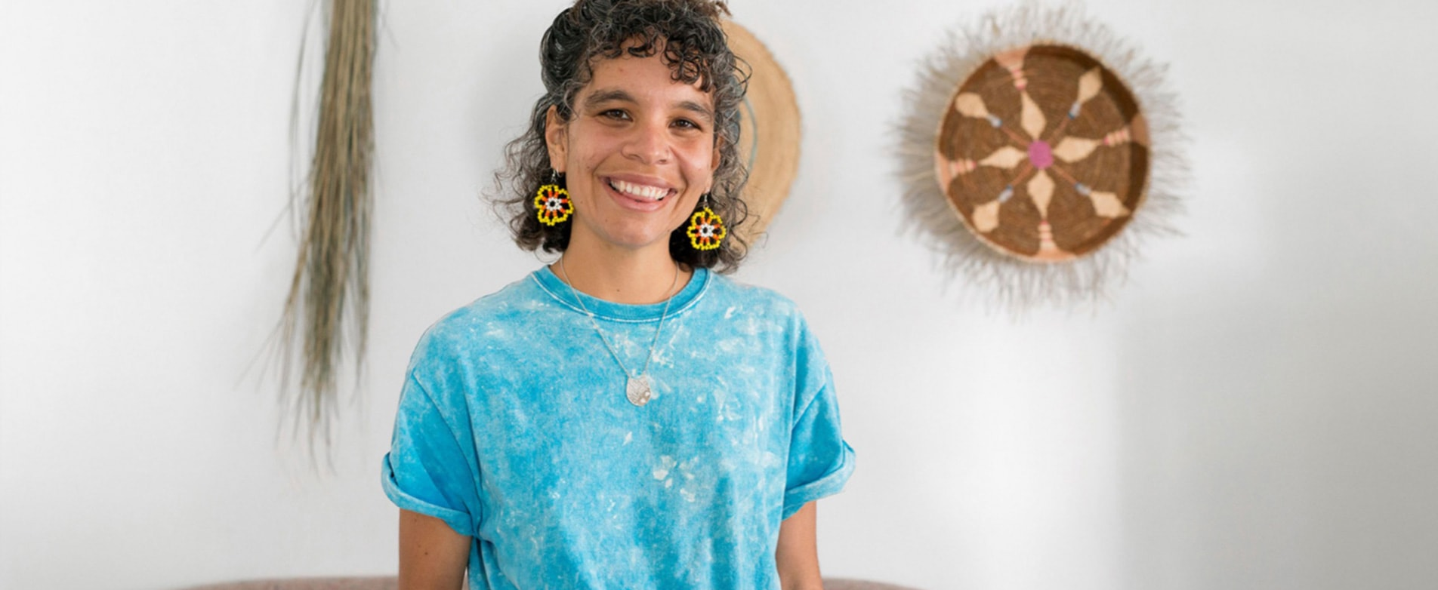
CASE STUDY
ELISA JANE CARMICHAEL

Slide 2
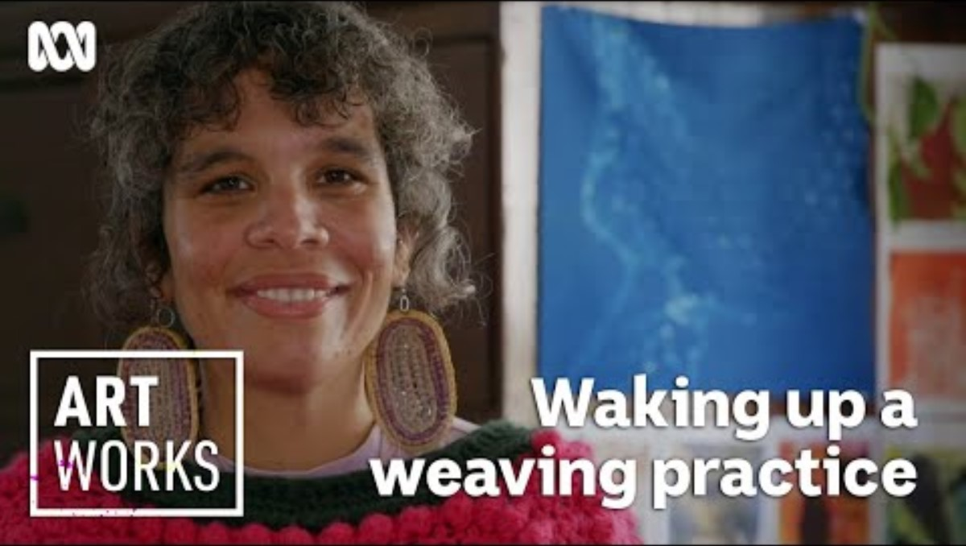


Artist Interview with Elisa Jane Carmichael

Slide 3
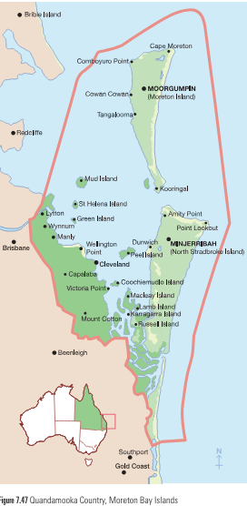
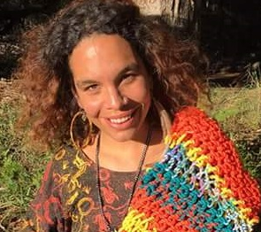
ELISA JANE CARMICHAEL
Elisa Jane Carmichael is a descendant of the Ngugi people from Quandamooka Country, Moreton Bay, Queensland.
Quandamooka People of Moreton Bay: Ngugi, Nunukul, and Gorempul clans.
Quandamooka people's care for country from the Brisbane River entrance along the Redlands coastline.
Carmichael is sixth-generation descendant of Junobin, an Apical Quandamooka ancestor. Her grandmother, Aunty Joan Hendriks, a Senior Quandamooka Elder, is regarded as one of Australia’s most respected Elders – for Carmichael family is the most important part of her life.
Mother Earth is the dwelling place of Creator Spirit and the water that flows through the veins of Mother Earth is our very life blood. We do not own the land, we are the custodians of the land, sand and waters of Quandamooka Country.
– Aunty Joan Hendriks, Senior Quandamooka Elder

Slide 4
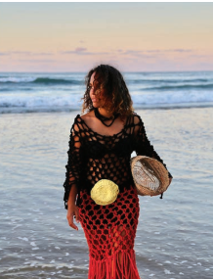
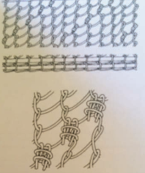
Summary of Elisa Jane Carmichael’s and her artistic practice
Weaving and Traditional Practices
- Exploration of traditional weaving practices, focusing on looping, knotting, coiling, and twining.
Contemporary Artwork and Fashion
- Regeneration of weaving practices into contemporary artwork and fashion.
- Use of traditional and non-traditional materials to revive traditional forms.
- Example: "Carrying Home (Saltwater)" as a blend of traditional weaving techniques and contemporary dress.
Artistic Expression and Symbolism
- Use of signs and symbols from Ngugi heritage.
- Passion for nurturing and preserving connection to sand and sea.

Slide 5
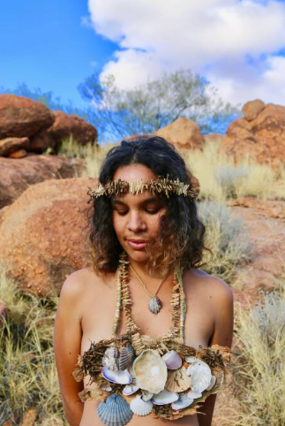
Environmental Inspiration and Identity
- Inspiration drawn from surrounding environments and cultural identity.
- Unconscious embedding of signs and symbols in artwork.
- Aesthetics reflecting observations of nature and cultural stories.
Artistic Techniques and Symbolism
- Absence of straight lines in artworks, mimicking wave movements.
-Symbolism of shells in "Home (Desert)" identifying Carmichael as a Saltwater woman.
-Use of shells to stay connected to Minjerribah during a residency.

Slide 6
KEY THEMES OF ELISA JANE MICHAEL’S ART PRACTICE
Elisa Jane Carmichael explores how visual language, symbol systems and art conventions can express ideas and feelings in images, objects and experiences. Carmichael has demonstrated that visual language has the potential to transcend and communicate across cultures, time and geography
My works weave together the country I am from and the place that I am in … one of the most significant sources of inspiration for me is the movement of Saltwater and the patterns Saltwater leaves behind as the tide goes in and the tide goes out.
– ELISA JANE CARMICHAEL
My practice-led research investigates traditional weaving techniques as a mode of contemporary fashion whilst acknowledging the strength and structure of our techniques as the first forms of Australian adornments and textiles.
– ELISA JANE CARMICHAEL

Slide 7
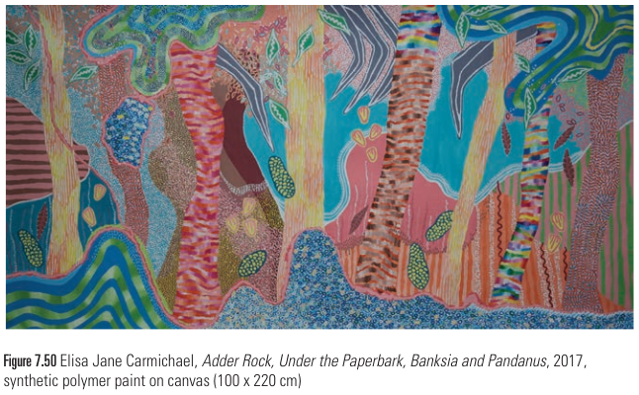
Lines
Look at Elisa Jane Carmichael’s Adder Rock, Under the Paperbark, Banksia and Pandanus and describe the appearance of the lines as a reflection of the waves.
Analyse where the artist has placed the lines. How has she created layers? Why do you think she has placed the lines throughout the composition in this way? What other interpretations can you have for these lines?
Texture
Look at Adder Rock, Under the Paperbark, Banksia and Pandanus and describe the textures you see throughout the composition. Compare how Carmichael has employed varied textures to create distinct features of the environment.

Slide 8
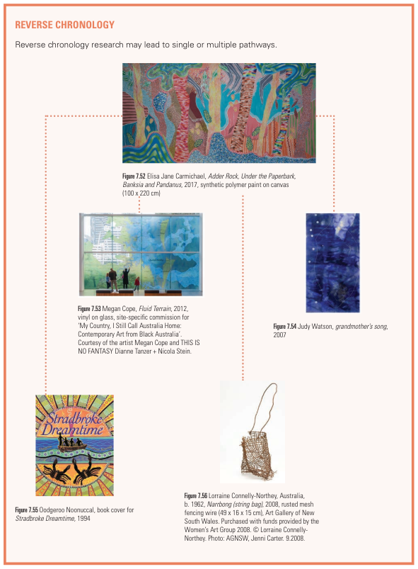
Review Questions
Analyse Elisa Jane Carmichael’s artworks through the cultural context to interpret representations of time, place, purpose, ethnicity, gender and spiritual beliefs.
How has Carmichael communicated meaning through artwork so that it is a vehicle to invite change and provoke conversation?
Carmichael incorporates discarded human-made materials with natural materials in her woven works. Create an experimental folio using both discarded human-made materials and natural materials to make objects that communicate your own cultural experience.

